Slide 1

KONERU LAKSHMAIAH EDUCATION FOUNDATION
DEPARTMENT OF ECE
ENGINEERING CAPSTONE PROJECT – Phase 2(22IE4054A)
AI-Based spoof detection
Group No: 2204004H
Guided By: Dr. A. K. VARMA

Slide 2
GROUP MEMBERS
2210040007 – S. B. HEMA ANJALI
2210040032 – CH. SAMYANA REDDY
2210040033 – P. NIKHITA REDDY
2210040044 – P. SREE VARSHA REDDY

Slide 3
Problem Statement
Advanced spoofing techniques like deepfake, replay, and voice conversion make it difficult to distinguish real and fake audio, requiring robust detection methods.
Existing systems fail to detect subtle artifacts and perform poorly in real-world conditions, creating a need for accurate and generalizable solutions.

Slide 4
OBJECTIVE
The primary objective is to develop an AI-based spoof detection system for identifying manipulated audio.
(i) To design effective features that capture differences between genuine and spoofed speech.
(ii) To build a robust model that ensures high accuracy in real-world scenarios.

Slide 5
Impact On Society
Enhances security in voice-based authentication systems (banking, payments, smart devices)
Prevents fraud and identity theft caused by deepfake audio attacks
Supports cybersecurity and digital trust in communication platforms
Helps in forensic analysis and law enforcement for verifying audio evidence

Slide 6
Knowledge Gap
Existing methods (MFCC, LFCC, LFRCC) capture limited speech characteristics
Lack of methods that combine both spectral and excitation information
Difficulty in detecting subtle artifacts in advanced deepfake audio
Poor performance under real-world conditions (noise, channel variations)
Limited focus on residual-based features like LFRCC

Slide 7
Dataset
Dataset: FOR-NORM (FAKE OR REAL NORMAL)
Subset: for-norm (normalized version)
Total utterances: 195,000+
Synthetic (fake) utterances: 87,000+
Real utterances: 111,000+
Contains both genuine and spoofed audio samples
Used for training, validation, and testing
Notes:
The dataset includes 9 types of modern attacks along with normal traffic.
Attack Type Description
1. Fuzzers Sending random data to applications to crash or find vulnerabilities.
2. Analysis Port scanning, vulnerability scanning, and fingerprinting
Backdoors Hidden access methods inserted into systems for remote control.
DoS (Denial of Service) Flooding or overloading a network/service to make it unavailable.
Exploits Exploiting software vulnerabilities (e.g., buffer overflow).6.
Generic Cryptographic brute-force attacks against ciphers (e.g., hash collisions).
Reconnaissance Gathering information about a target before attack (ping sweep, port scan).
Shellcode Code that exploits software vulnerabilities to gain shell access.
Worms Self-replicating malware spreading through the network.
Normal Legitimate benign network traffic.

Slide 8
Methodology
.
Audio preprocessing (normalization + VAD + framing)
Segmentation into 25 ms frames with 10 ms overlap
Feature extraction using LFRCC (residual + spectral features)
LP order optimization (optimal value = 8)
Feature enhancement using static + delta + double-delta (39D)
Classification using TDNN (temporal modeling)
Evaluation using Accuracy, F1-score, and EER

Slide 9
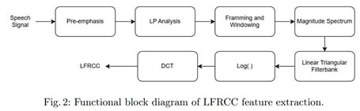
Proposed Architecture
The input signal is first resampled to 16 kHz then the signal is sampled with a window length of 30 seconds, and a hop length of 15 ms to obtain MFCC, LFCC, and LFRCC features.
• The LFRCC are obtained by processing the spectral envelope of an audio signal to remove pitch influence.
• LFRCC capture the essence of a sound’s spectral shape, minus the influence of pitch.
• This study employs a TDNN model with 5 convolutional layers, each with 40 sub band filters including max pooling, dropout, and batch normalization layer and latency period of 600 ms.

Slide 10
LP Residual And LFRCC
LP Residual
Isolates the difference between the actual speech and a predicted linear model: e(n) = x(n) − ˆx(n).
Captures information about the vocal tract and glottal source: e(n) emphasizes source characteristics not captured by the prediction model.
Linear frequency residual cepstral coefficient (LFRCC)
LFRCCs are derived from the LP residual.
Capture information about the speech source after separating the spectral envelope and fine structure.
Differentiate from MFCCs by focusing on the LP residual in the cepstral domain.
Captures pitch and formant information.
Extraction involves cepstral transformation.

Slide 11
Model (TDNN)
TDNNs are neural networks that handle sequential data by using time-delay layers to capture temporal context.
Effective for tasks like speech recognition and audio processing.
TDNNs leverage convolutional layers with shared weights across time to process sequential data efficiently.
They are capable of learning hierarchical representations of temporal patterns, enhancing their effectiveness in capturing nuanced features in speech and audio.
TDNNs use time-delay layers to capture temporal context efficiently in sequential data processing tasks.

Slide 12
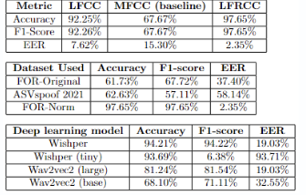
Results
LFRCC achieves superior results (97.65% accuracy, 97.65% F1-score, 2.35% EER) compared to MFCC and LFCC using TDNN.
TDNN achieves performance parity (97.65% accuracy, 97.65% F1-score, 2.35% EER) with FOR-Norm dataset.
FOR-Norm dataset shows consistent performance (97.65% accuracy, 97.65% F1-score, 2.35% EER) across cross-dataset analysis.
Latency analysis identifies 600ms as optimal, yielding 2.35% EER, superior to MFCC and LFCC.

Slide 13
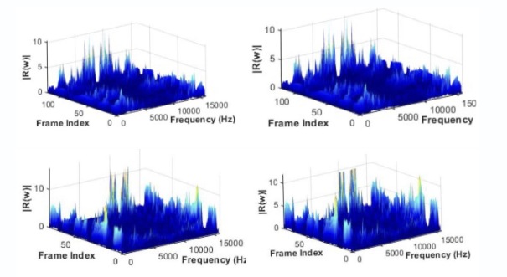
Statistical Analysis
Plots of framewise magnitude spectrum of LP residual, i.e., |R()| ofthe LP residual of real vs. fake speech, for different LP order 2 and 8, respec-tively, for Fake audio and real audio: Fig. (a), Fig. (b), Fig. (c), and Fig. (d) ofeach panel depicts the time-domain waveform, Mel Spectrogram, STFT spec-trogram.

Slide 14
Results
Raw HDFS logs are transformed into structured, block-level log sequences
Each sequence is assigned an anomaly score using LSTM Autoencoder reconstruction error
Sequences exceeding a defined threshold are identified as anomalous
Anomalies are visualized using tables and graphs for easy interpretation
The system highlights abnormal system behavior to assist cyber forensic analysis
Expected performance: >90% anomaly detection accuracy with low false positive rate

Slide 15
Conclusion
Introduced Order-Optimized LFRCC for deepfake detection.
• LFRCC achieves superior performance with 2.36% EER using aTDNN classifier.
• Outperformed MFCC (15.30% EER) and LFCC (7.62% EER) in de-tecting deepfake audio.
• LFRCC demonstrates more effective noise robustness comparedto MFCC and LFCC across various SNR levels.
• Demonstrates LFRCC’s capability to detect subtle distortionscharacteristic of deepfake audio effectively.

Slide 16
References
[1] G. Fant, Speech Acoustics and Phonetics: Selected Writings, vol. 24, Springer, 2004. https://link.springer.com/book/10.1007/978-94-017-0357-1
[2] J. Makhoul, ‘‘Linear prediction: A tutorial review,’’ Proc. IEEE, vol. 63, no. 4, pp. 561–580, 1975. https://doi.org/10.1109/PROC.1975.9792
[3] C. Hanilçi, ‘‘Speaker verification anti-spoofing using linear prediction residual phase features,’’ in Proc. EUSIPCO, 2017, pp. 96–100. https://ieeexplore.ieee.org/document/8081370
[4] E. Jokinen, R. Saeidi, T. Kinnunen, and P. Alku, ‘‘Vocal effort compensation for MFCC feature extraction,’’ Comput. Speech Lang., vol. 53, pp. 1–11, 2019. https://doi.org/10.1016/j.csl.2018.08.004
[5] S. Cheedella, S. Gupta, and B. Yegnanarayana, ‘‘Extraction of speaker-specific excitation information,’’ Speech Commun., vol. 48, no. 10, pp. 1243–1261, 2006. https://doi.org/10.1016/j.specom.2006.03.004

Slide 17
Thank you

